Slide 1

Arrival ® package scanning software

Slide 2
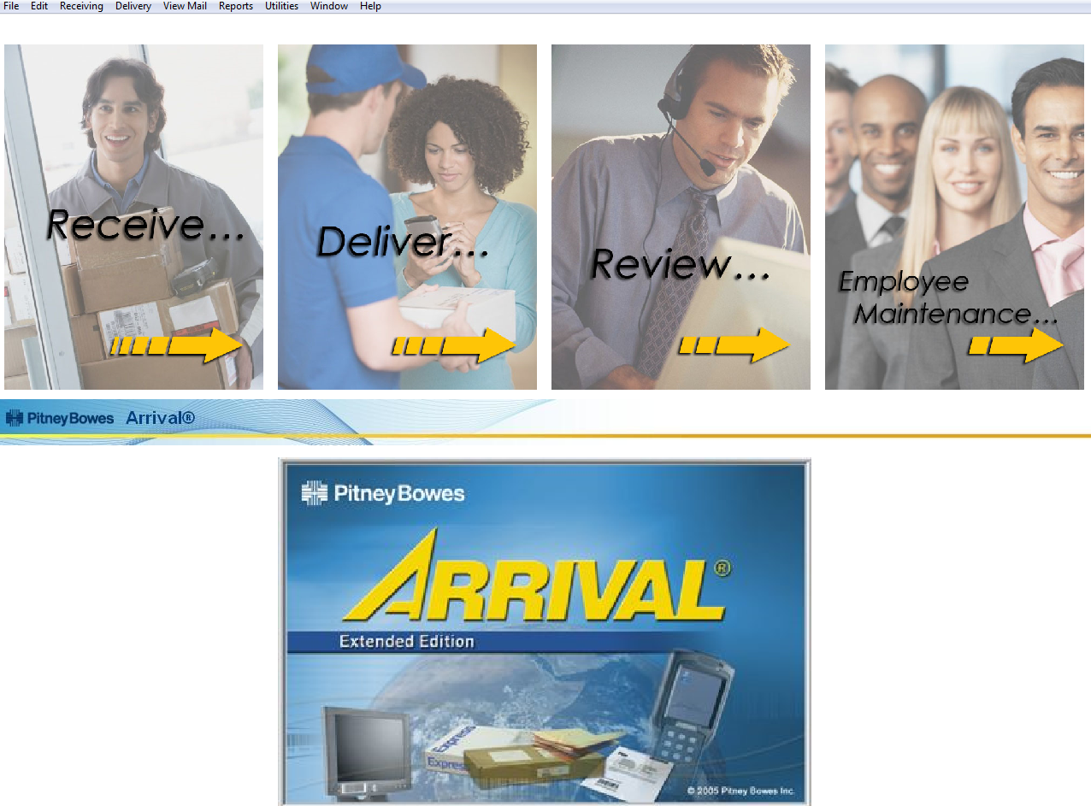
Opening Screen

Slide 3
Do not TOUCH!
Logging packages IN
Logging packages OUT

Slide 4
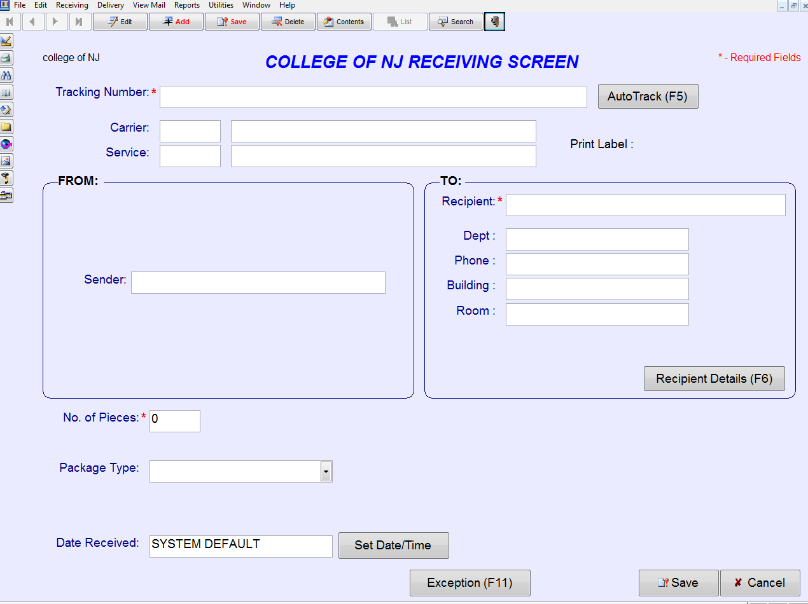
package logging IN screen

Slide 5
Step 1: add

Slide 6
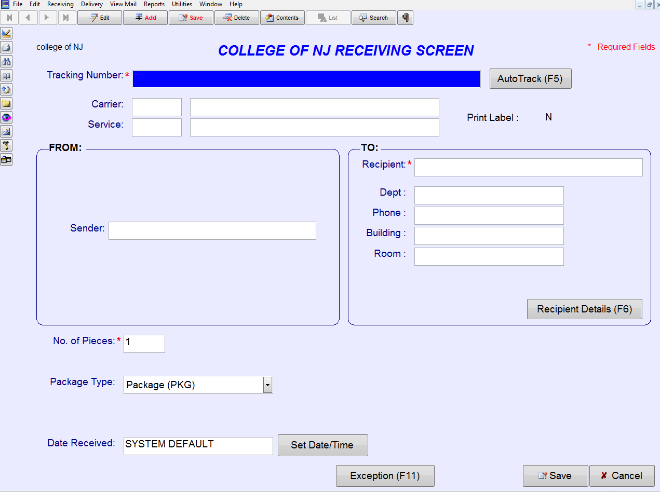
Tracking number field becomes active

Slide 7
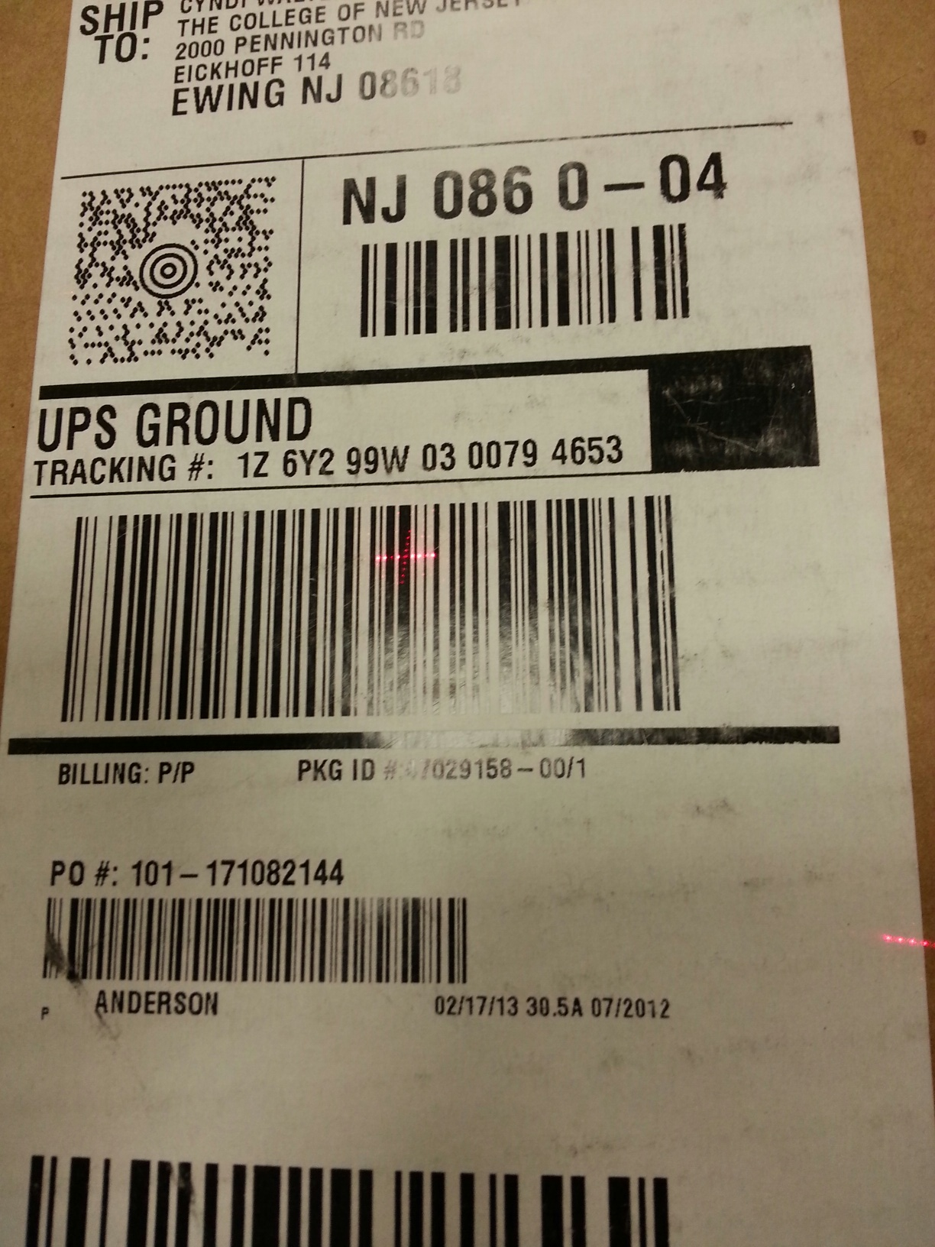
Scan the barcode with the tracking number

Slide 8
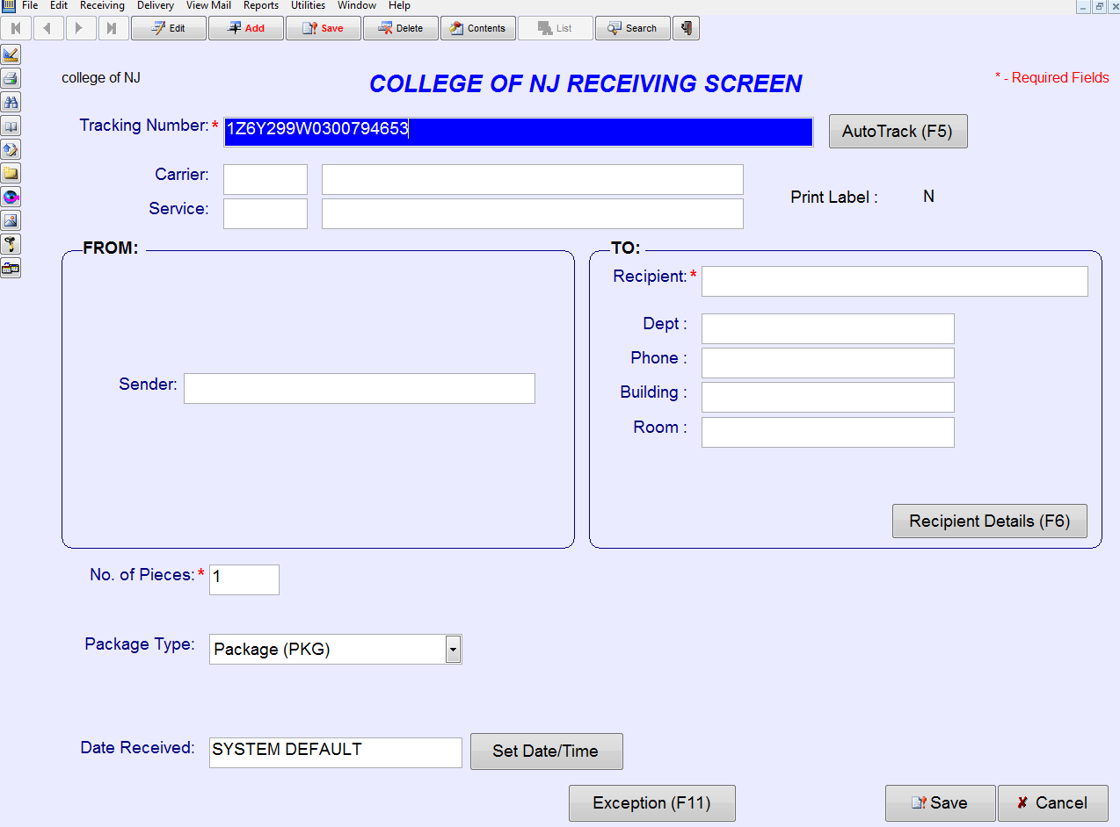
Field populates with tracking number

Slide 9
Step 3: Click on Recipient

Slide 10
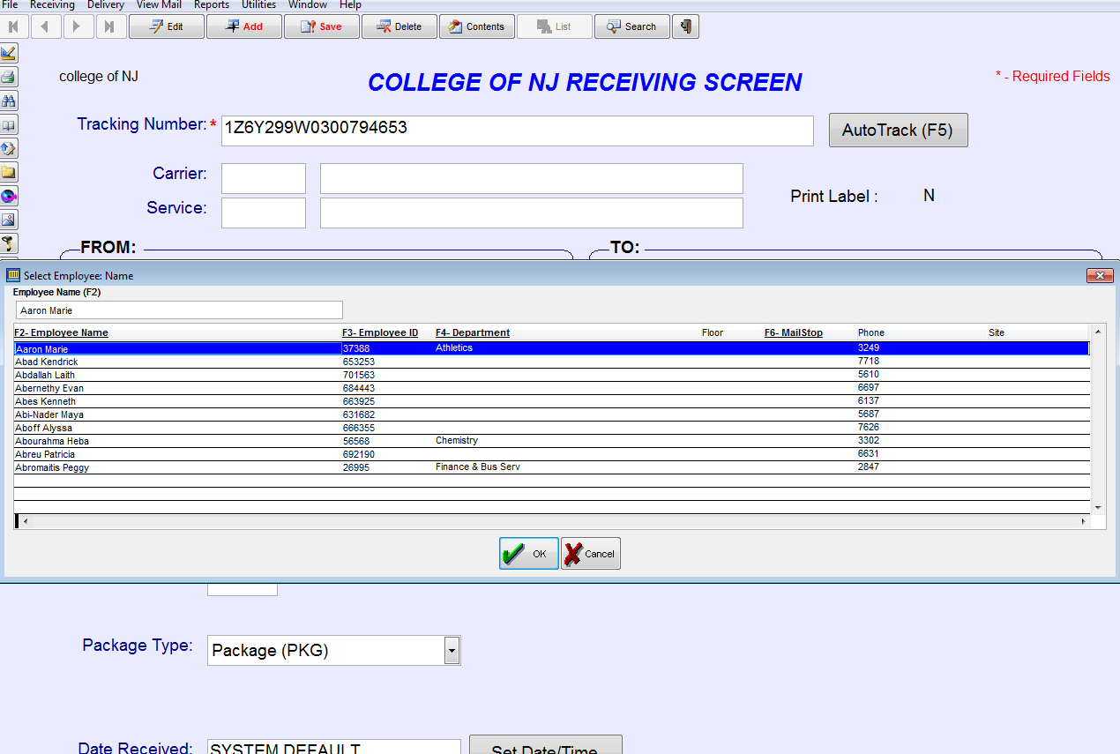
Recipient list will pop up

Slide 11
Type student’s name in search last name first,
ie Stallings Sean

Slide 12
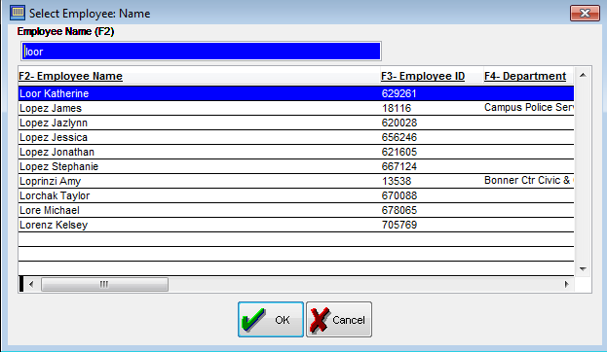
tip: use the delete key rather than backspace to erase!
Click ok when the correct student is highlighted

Slide 13
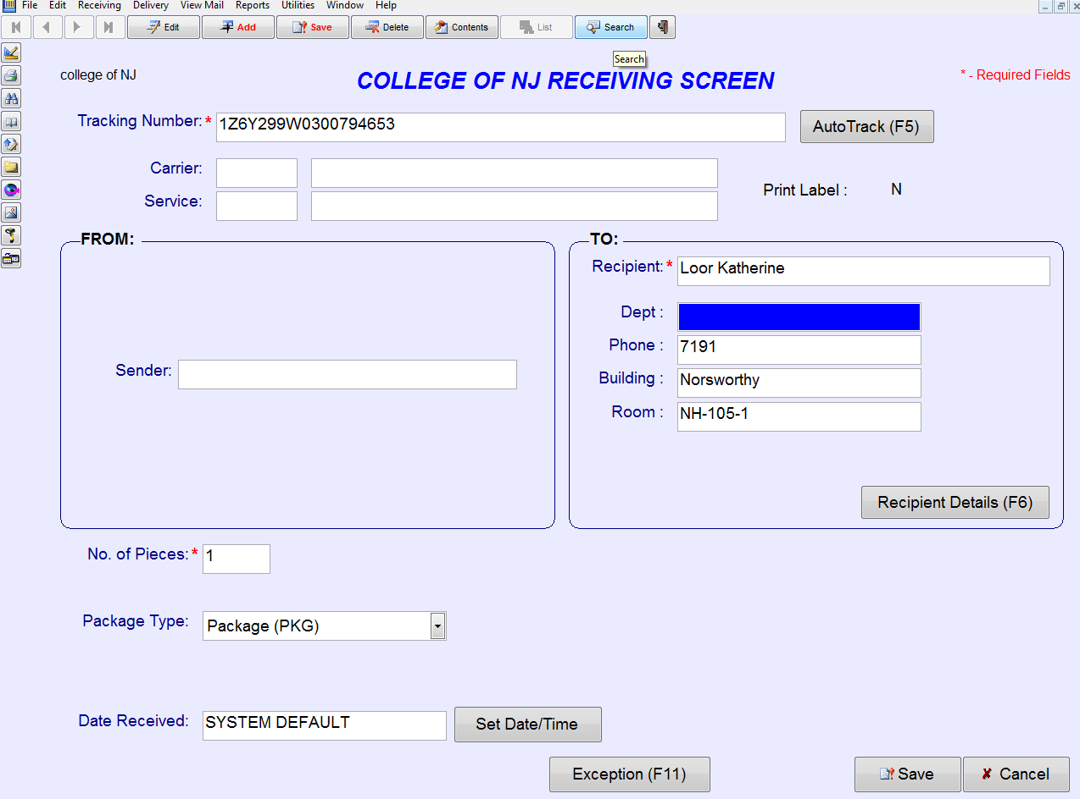
Student’s info will auto populate

Slide 14
Step 4: Save your work!

Slide 15
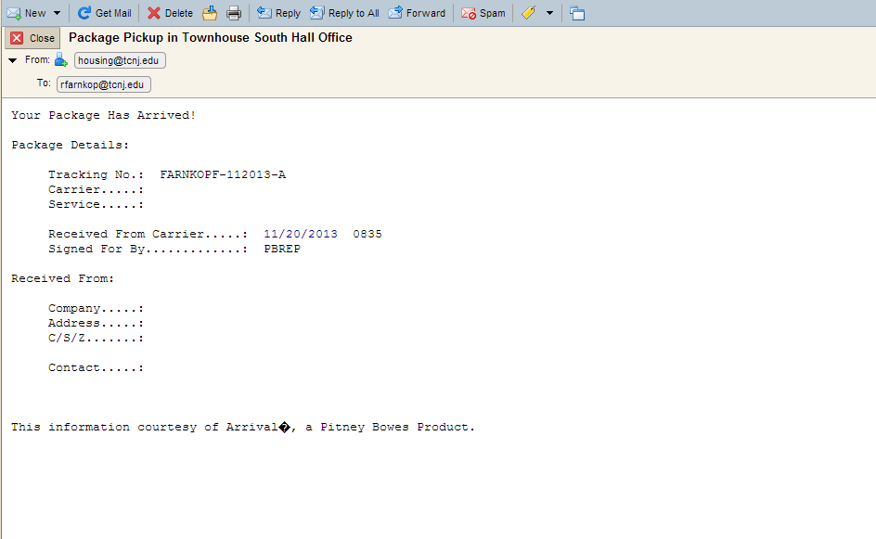
Package is logged and student instantly receives an email with tracking number. Email subject line has the package pickup location.

Slide 16


Slide 17


To exit this screen, click the exit door icon

Slide 18
Do not TOUCH!
Logging packages IN
Logging packages OUT
Let’s log some packages OUT

Slide 19
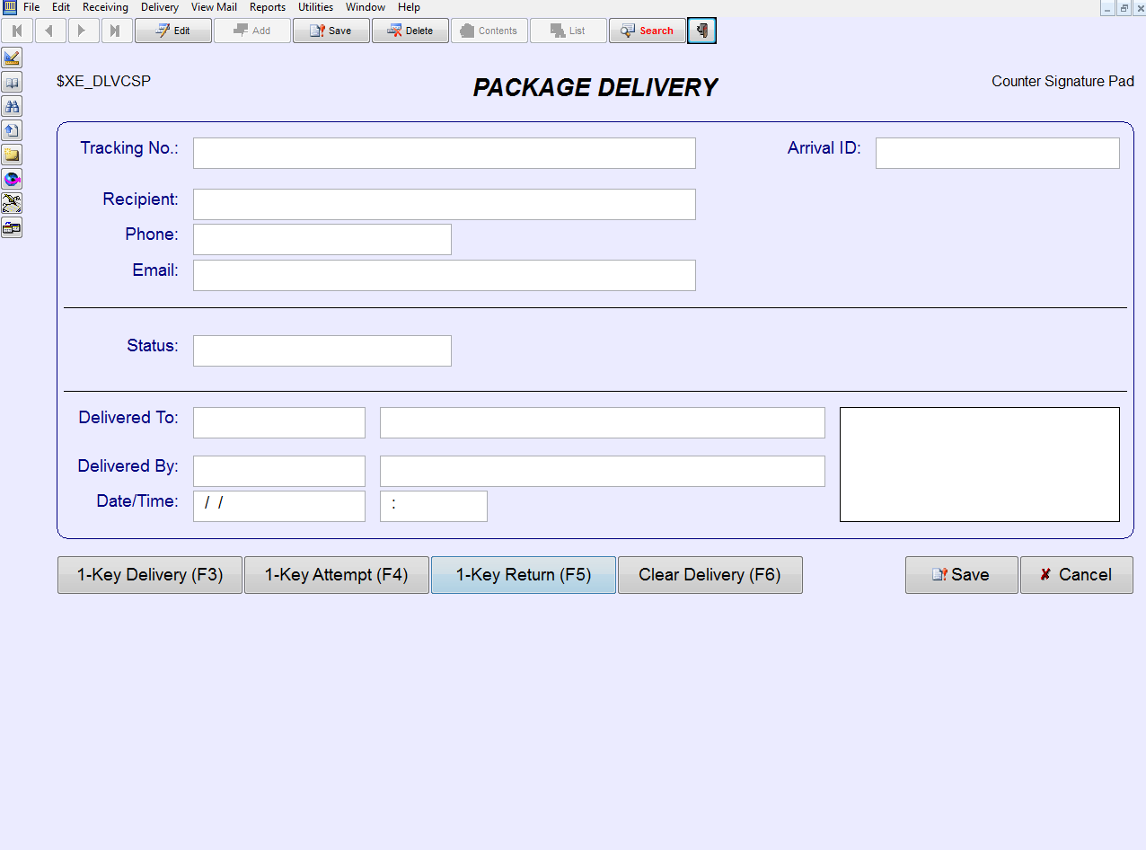
Step 1: search

Slide 20
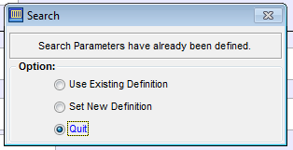
If you get this pop up, select NEW DEFINITION

Slide 21
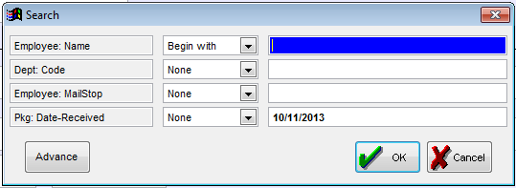
Select ‘begin with’ and type in student’s last name

Slide 22
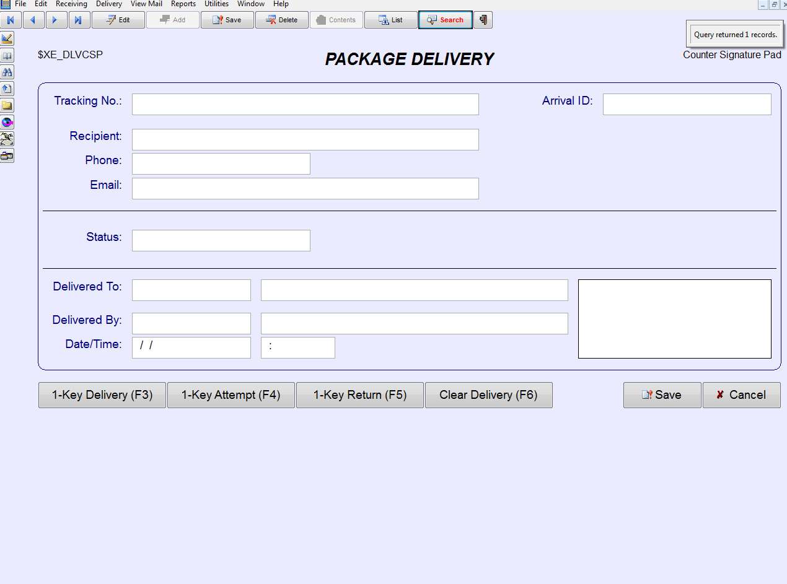
Step 2: List…this will list all the packages this student has in the system.

Slide 23
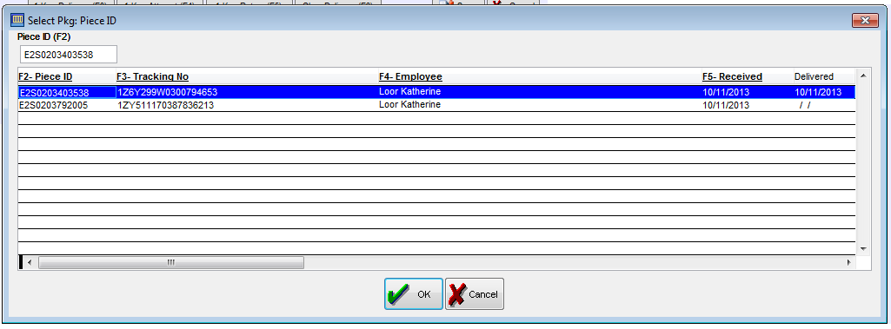
Student Name
Delivered Date
Logged In Date
Select the appropriate package!

Slide 24
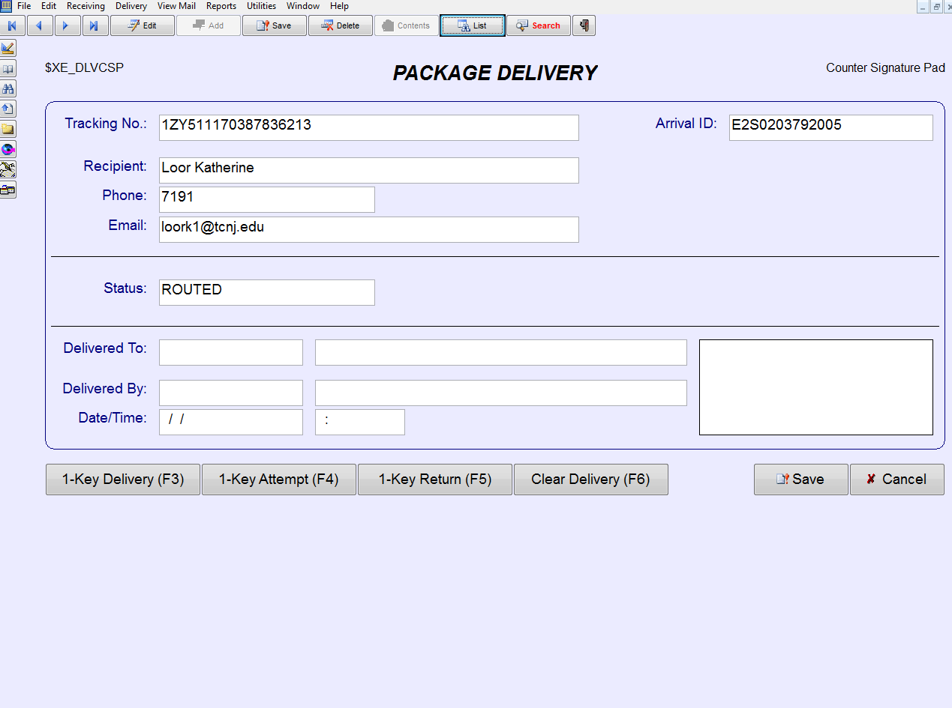
Click delivery (or hit F3)!

Slide 25
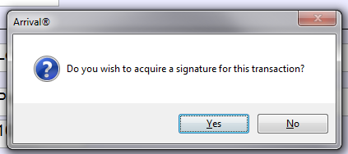
Yes, we want a signature!

Slide 26
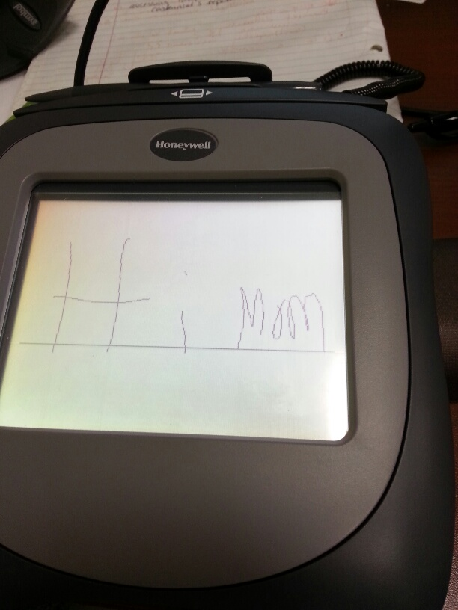
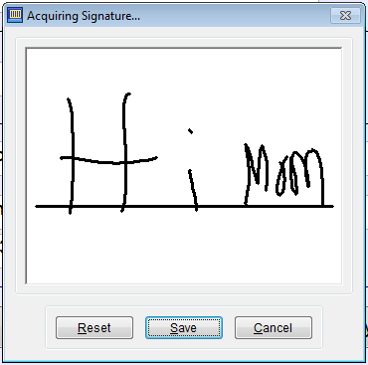
Pad is ready…have student sign then click save

Slide 27
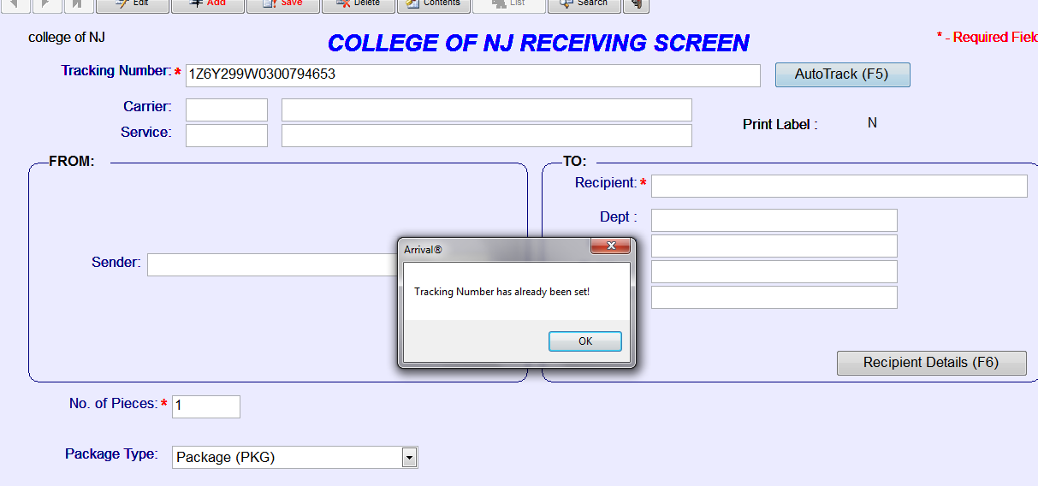
To exit this screen, click the exit door icon

Slide 28
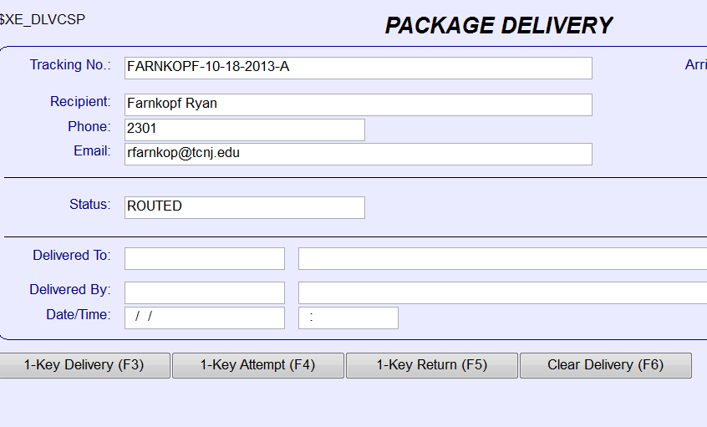
If the package tracking number is damaged/not visible, use the following format:
Last name-received date-package number (a, b, c, etc.) as shown above

